Slide 1
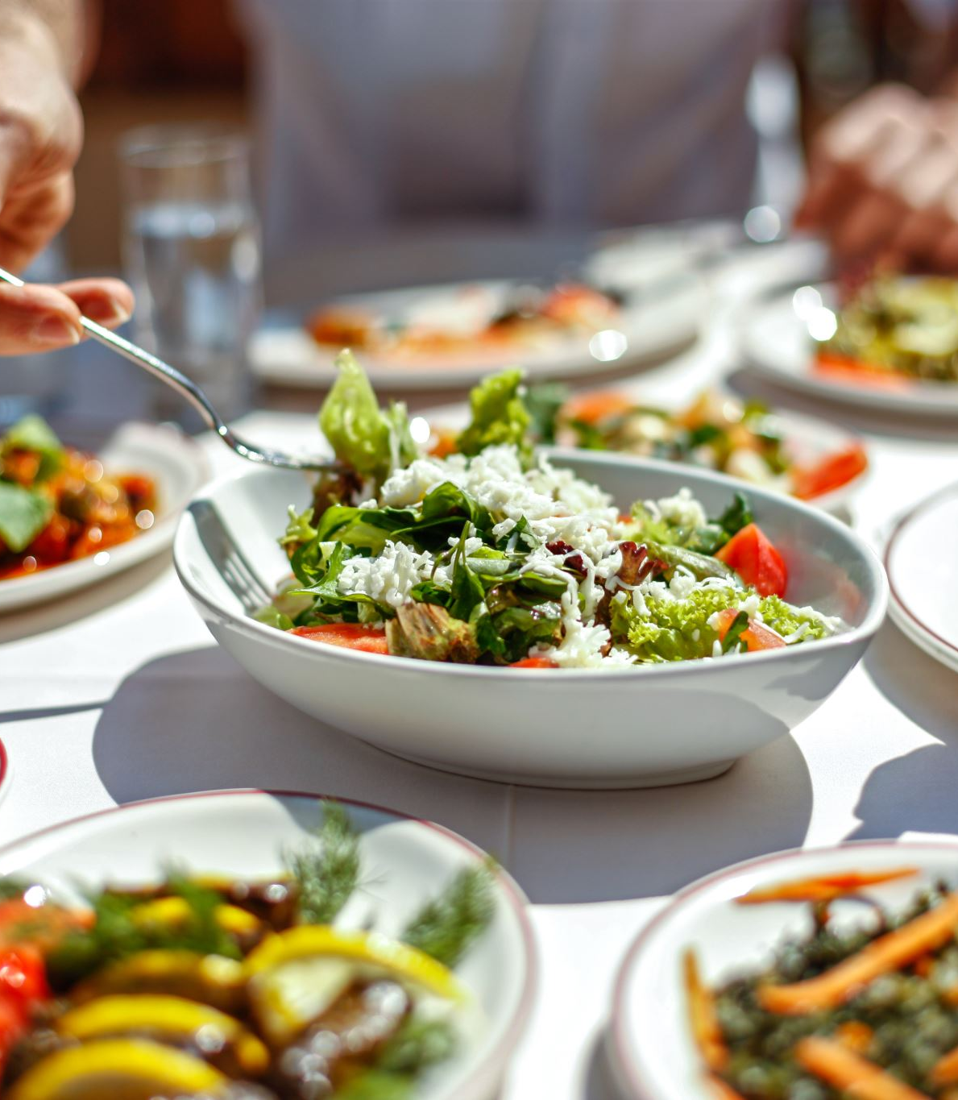
RESTAURANT OPERATIONS ANALYSIS BY SOFIA CRASTO

Slide 2
The Assignment
 | The Taste of the World Café debuted a new menu at the start of the year.'ve been asked to analyze customer data to identify: Which menu items are performing well or poorly What the top customers seem to prefer

Slide 3

The Objectives
Explore
Explore the menu_items table to understand the new offerings.
Explore
Explore the order_details table to review collected customer data.
Combine
Combine insights from both tables to assess customer reactions to the new menu.

Slide 4
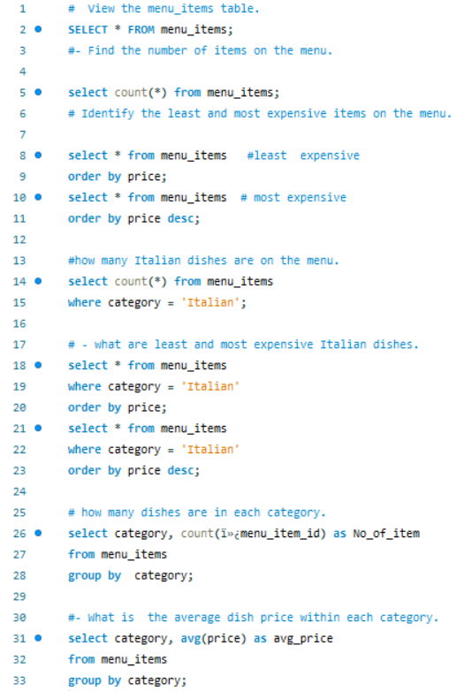
Objective 1: Explore the menu_items Table
View the menu_items table.
Find the number of items on the menu.
Identify the least and most expensive items on the menu.
Determine how many Italian dishes are on the menu.
Find the least and most expensive Italian dishes.
Count how many dishes are in each category.
Calculate the average dish price within each category.

Slide 5
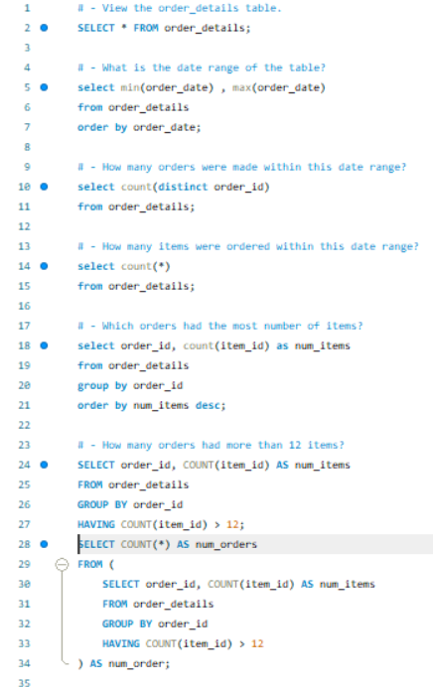
Objective 2: Explore the order_details Table
View the order_details table. What is the date range of the table?
How many orders were made within this date range?
How many items were ordered within this date range?
Which orders had the most number of items?
How many orders had more than 12 items?

Slide 6
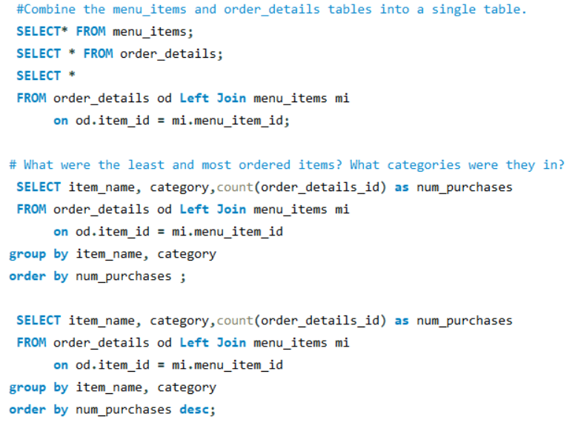
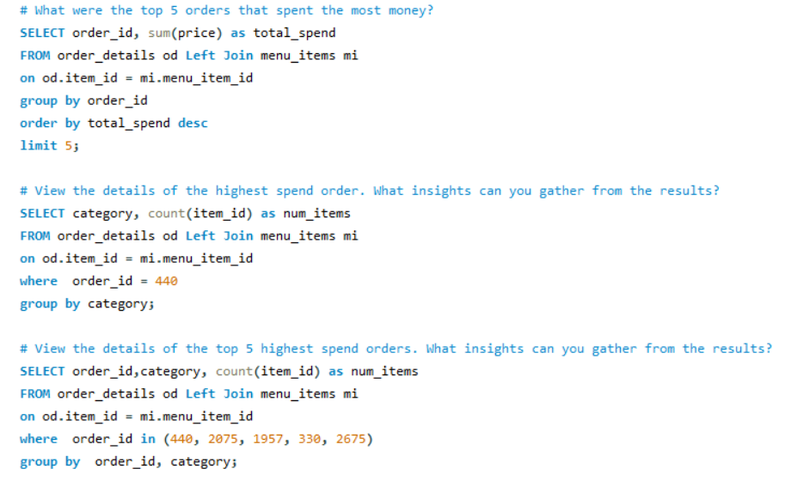
Objective 3: Analyze Customer Behavior
Combine the menu_items and order_details tables into a single table.
What were the least and most ordered items? What categories were they in?
What were the top 5 orders that spent the most money?
View the details of the highest spend order. What insights can you gather from the results?
Bonus: View the details of the top 5 highest spend orders. What insights can you gather from the results?

